Slide 1
Wasel
Redefining ride-hailing

Slide 2
OPERATING ENVIRONMENT
60,000
people work through ride-hailing apps in Jordan
(licensed + unlicensed).
45,000
drivers are estimated to be operating without full licensing.

Slide 3
OPERATING ENVIRONMENT
In 2024, the government blocked 24 unlicensed ride-hailing apps and have committed to strengthening regulations.
A recent change in government policy took place allowing for new ride hailing companies to enter to reduce the high commission rates, revoking the new app ban to incentivize foreign and domestic investment in the transportation sector to promote competition.
Husna fm
Jordan Times

Slide 4




COMPETITIVE LANDSCAPE
Global
Players
Regional
Players
Domestic Players
Despite the presence of international players, local ride-hailing companies like Careem dominate the Jordanian market due to their understanding of cultural nuances.

Slide 5
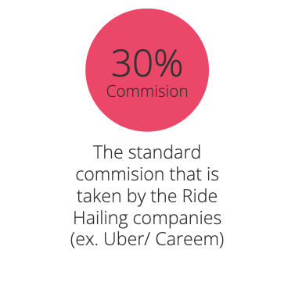
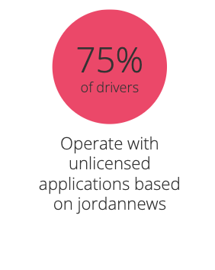
MARKET CHALLENGE
Ride Hailing Drivers are struggling to make a living with the current financial model because a big % is going to the company.
They are resorting to unlicensed apps with lower commission rates as a result.
Locally, this economic model is proving to be unsustainable especially as number of drivers grew resulting in less rides/driver/day.
Jordan news

Slide 6
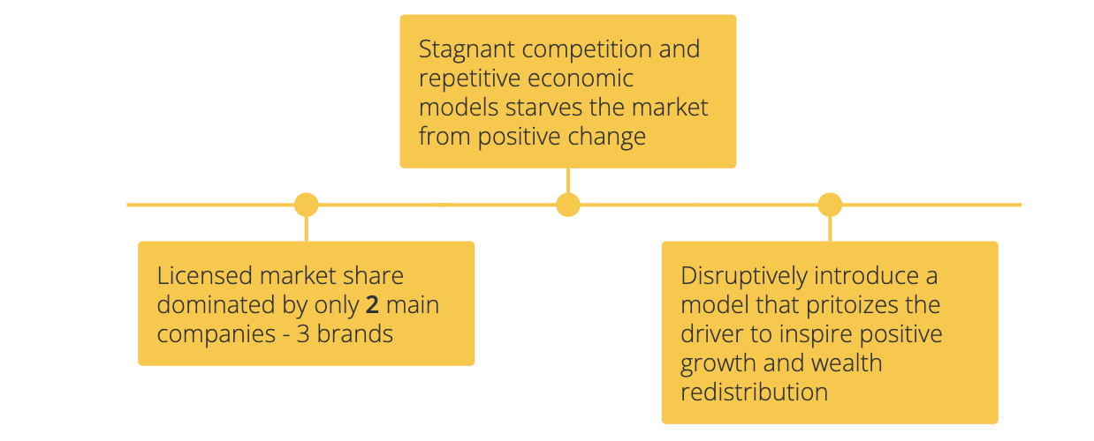
MARKET CHALLENGE
Limited competition lead the way to abusive profit margins amongst big players (Uber/ Careem/ Jeeny):

Slide 7
MARKET OPPORTUNITY
Disrupt the existing financial model by introducing fairer compensation that will make it lucrative to both drivers and the company.

Slide 8
THE SOLUTION
Our solution replaces commissions with a tiered flat monthly subscription, allowing drivers to keep 100% of their ride earnings.
This aligns incentives, restores trust, and makes compliance economically rational for drivers while stabilizing the market overall.
A more sustainable business model for all.
We don’t employ drivers; we work with them.

Slide 9
THE IDEA
DRIVERS BENEFITS
COMPANY BENEFIT
Customers
100% of their ride earnings
Subscription Monthly
Advertising
Support/
Customer care

Slide 10
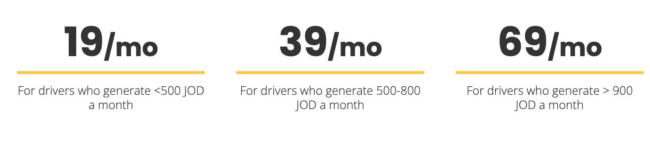
THE TIERED SUBSCRIPTION MODEL
Wassel takes a monthly subscription which changes based on the amount of money generated.

Slide 11
THE MORE THEY MAKE, THEY GET:
Priority Customers
–
Care/Protection
–
Higher Rated Users

Slide 12
ROADMAP
Fintech, financial tools, insurance incentives, car finances, maintenance connections etc.

Slide 13
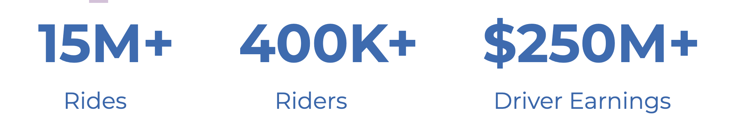

PROOF OF CONCEPT…. NY, DC, MIAMI
EMPOWER, is a similar company that found success in large cities proving the concept has traction in the world’s largest markets.
Riders using Empower pay 20% less on average compared to Uber or Lyft.
driveempower

Slide 14
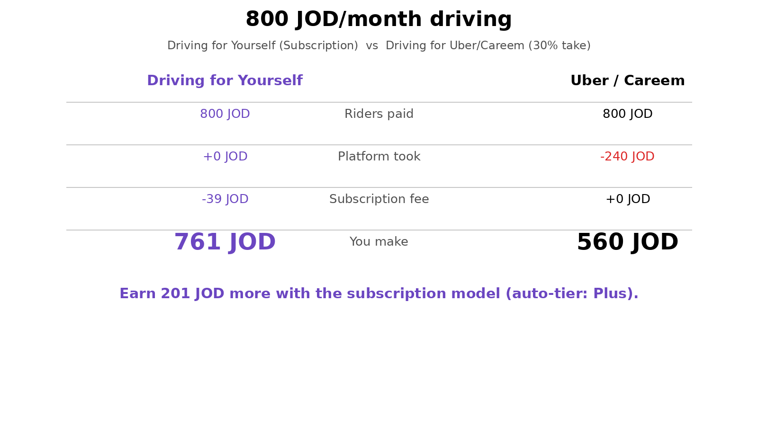

Slide 15
PILOT MARKET POTENTIAL - AMMAN
Annual growth rate
at a rate of 6.18%,
By 2025, the revenue in this market is projected to reach US$63.36m and is expected to grow annually at a rate of 6.18%, resulting in a market volume of US$85.53m by 2030.
Statista

Slide 16


PILOT MARKET POTENTIAL - AMMAN
It is estimated that the number of users in this market will amount to 3.26m users by 2030, with user penetration projected to be 26.2% by 2030.
Statista

Slide 17
FINANCIAL PROJECTIONS - AMMAN

Slide 18
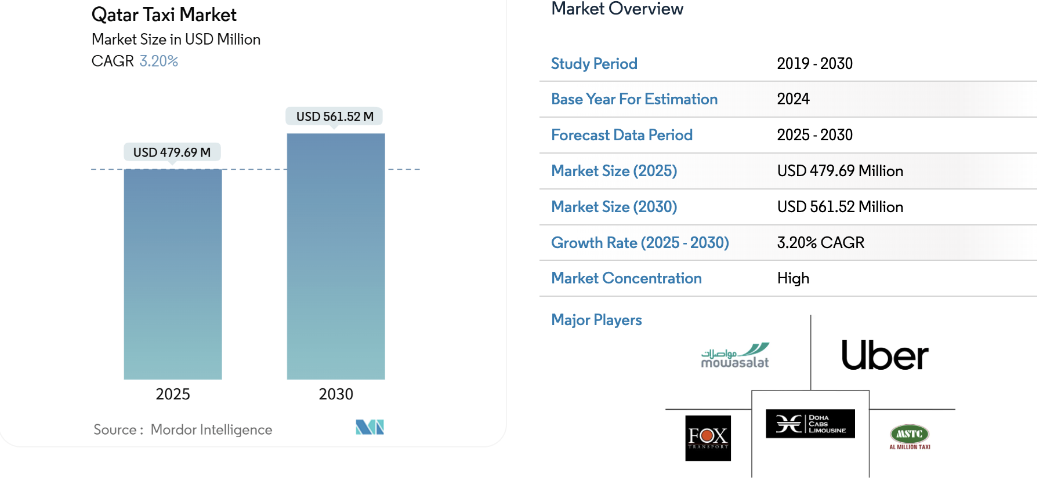
BROADER MARKET POTENTIAL
https://www.mordorintelligence.com/industry-reports/qatar-taxi-market

Slide 19
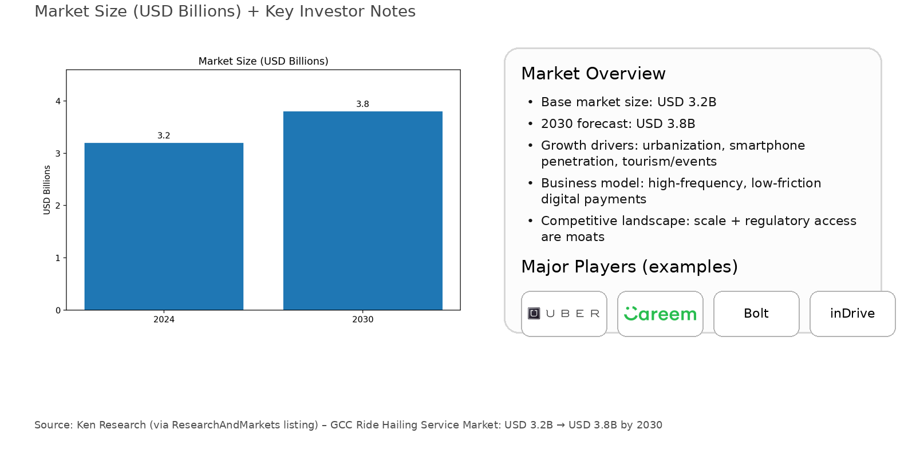



BROADER MARKET POTENTIAL - GCC

Slide 20
INVESTMENT REQUIRED
Local Offices: Management HQ, Customer Care, Onboarding Driver center
Legal and regulation: Permits, Insurance, Licensing
Workforce: Management employees, customer care employees, legal team, advertising team, strategic roles
Training centers: Quality control, safety standards, people skills training
Tech: Servers, maintenance workers, developers

Slide 21
INVESTMENT REQUIRED – AMMAN
GOVT LICENSE
JD100,000
APP & IT
JD100,000
WORKING CAPITAL
OPEX&CAPEX
LEGAL
ADVERTISING

Slide 22
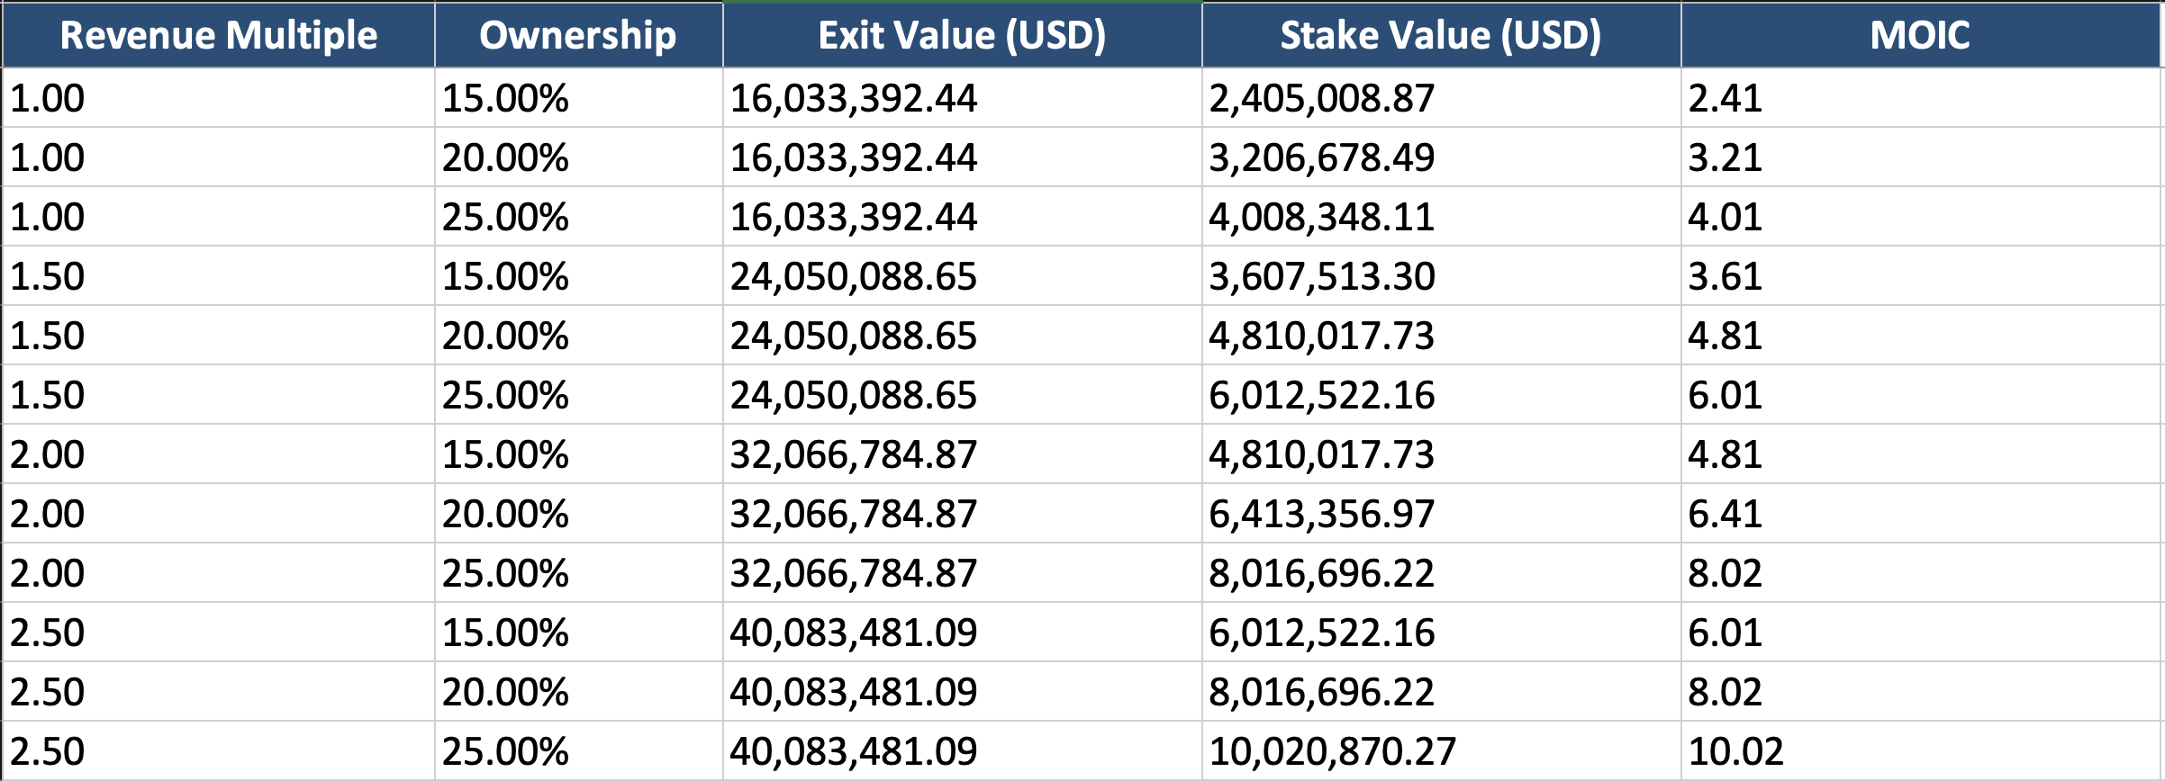
EXIT STRATEGY
*IDK if this slide is important

Slide 23
TEAM
Us!

